Slide 2
LEARNING OBJECTIVES
To define what the business plan is, who prepares it, who reads it, and how it is evaluated.
To understand the scope and value of the business plan to investors, lenders, employees, suppliers, and customers.
To identify information needs and sources for each critical section of the business plan.

Slide 3
LEARNING OBJECTIVES
Contd…
To enhance awareness of the value of the Internet as an information resource and marketing tool.
To appreciate examples and a step-by-step explanation of the business plan.
To develop helpful questions for the entrepreneur at each stage of the planning process.
To understand how to monitor the business plan.

Slide 4
WHAT IS THE BUSINESS PLAN?
Written document describing:
Relevant internal and external elements
Strategies for starting a new venture
Integrates functional plans
Addresses short and long-term decision making for the first three years of operation

Slide 5
WHAT IS THE BUSINESS PLAN?
Contd…
Prepared by the entrepreneur in consultation with others
Requires objective assessment of individual skills

Slide 6
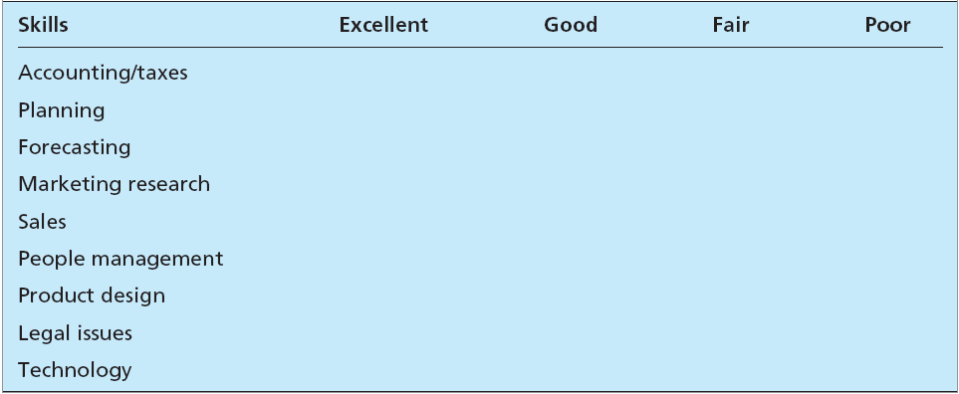
SKILLS ASSESSMENT TABLE 7.1

Slide 7
SCOPE AND VALUE OF THE BUSINESS PLAN—WHO READS THE PLAN?
Scope
Determined by who is expected to read the plan
A plan should consider the:
Entrepreneur’s perspective
Marketing perspective
Investor's perspective

Slide 8
SCOPE AND VALUE OF THE BUSINESS PLAN—WHO READS THE PLAN?
Contd…
Depth and detail in the business plan depends on:
Size and scope of the proposed new venture
Size of the market
Competition
Potential growth

Slide 9
SCOPE AND VALUE OF THE BUSINESS PLAN—WHO READS THE PLAN?
Contd…
Business plan is valuable because it:
Helps determine the viability of the venture in a designated market
Guides the entrepreneur in organizing planning activities
Serves as an important tool in helping to obtain financing

Slide 10
HOW DO POTENTIAL LENDERS AND INVESTORS EVALUATE THE PLAN?
The business plan must reflect:
Strengths of the management and personnel
Product/service
Available resources
Lenders
Interested in the venture’s ability to pay back the debt
Focus on the four Cs of credit - Character, cash flow, collateral, and equity contribution

Slide 11
HOW DO POTENTIAL LENDERS AND INVESTORS EVALUATE THE PLAN?
Contd…
Banks - Interested in analysis of the business opportunity and risks
Investors
Emphasize on the entrepreneur’s character
Conduct background checks
Demand high rates of return
Focus on market and financial projections

Slide 12
PRESENTING THE PLAN
An entrepreneur should:
Focus on why this is a good opportunity
Provide an overview of the marketing program
Address risks and how to overcome them
Investors describe these presentations as elevator pitches

Slide 13
INFORMATION NEEDS
Establish well-defined goals and objectives
Undertake a feasibility study
Information for a feasibility study should focus on marketing, finance, and production

Slide 14
AN UPSIDE-DOWN PYRAMID APPROACH TO GATHERING MARKET INFORMATION
General environmental and demographic trends
National food industry trends
Local environmental and demographic trends
Local food industry trends
Local competition strengths and weaknesses

Slide 15
OPERATIONS INFORMATION NEEDS
Location
Manufacturing operations
Raw materials
Equipment
Labor skills
Space
Overhead

Slide 16
FINANCIAL INFORMATION NEEDS
Prepare a budget listing all possible expenditures
Forecast sales revenue on the basis of market data
Identify industry benchmarks to prepare the final pro forma statements

Slide 17
USING THE INTERNET AS A RESOURCE TOOL
Provides information for:
Industry analysis
Competitor analysis
Measurement of market potential
Is useful for:
Later-stage planning and decision making
Provides opportunities for marketing strategy

Slide 18
WRITING THE BUSINESS PLAN
Introductory page
Executive summary
Environmental and industrial analysis
Environmental analysis: Assessment of external uncontrollable variables that may impact the business plan
Industrial analysis: Reviews industry trends and competitive strategy

Slide 19
WRITING THE BUSINESS PLAN
Contd…
Description of venture: Complete overview of the products, services, and operations

Slide 20
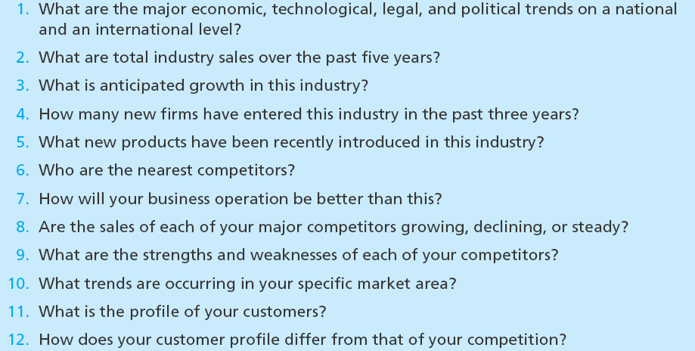
CRITICAL ISSUES FOR ENVIRONMENTAL AND INDUSTRY ANALYSIS Table 7.5

Slide 21
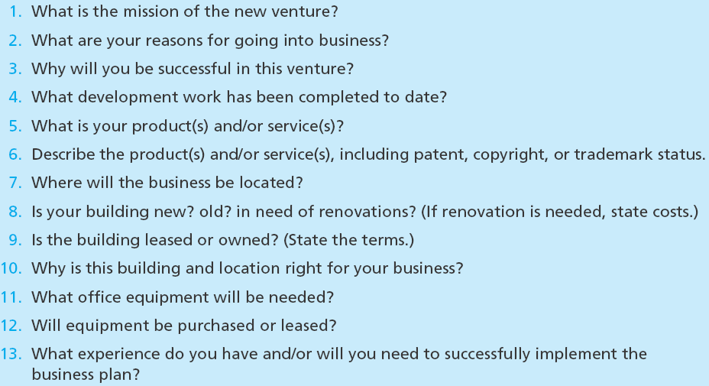
DESCRIBING THE VENTURE TABLE 7.6

Slide 22
WRITING THE BUSINESS PLAN
Production plan: Details of how product will be manufactured
Operations plan
Marketing plan: Describes market conditions and strategy related to:
How the product and service will be distributed, priced, and promoted

Slide 23
WRITING THE BUSINESS PLAN
Contd…
Organizational plan: Describes:
Form of ownership
Lines of authority and responsibility
Assessment of risk
Identifies potential hazards and alternative strategies to meet goals and objectives

Slide 24
WRITING THE BUSINESS PLAN
Contd…
Financial plan: Projection of key financial data that determine:
Economic feasibility
Necessary financial investment commitment
Appendix

Slide 25
MEASURING PLAN PROGRESS
Determines whether the goals or objectives are on schedule
Reviews
Profit and loss statement
Cash flow projections
Inventory control

Slide 26
MEASURING PLAN PROGRESS
Contd…
Production control
Quality control
Sales control
Disbursements
Web site control

Slide 27
USING AND IMPLEMENTING THE BUSINESS PLAN
Updating the plan
Monitor changes in the company, industry, and market
Determine what revisions are needed if changes are likely to affect the business plan
Advantages
Helps maintain reasonable targets and goals
Increases the probability of success for a new venture

Slide 28
WHY SOME BUSINESS PLANS FAIL
Unreasonable goals
Non measurable objectives
Lack of commitment to the business or to the family
Lack of experience in the planned business

Slide 29
WHY SOME BUSINESS PLANS FAIL
Contd…
No sense of potential threats or weaknesses to the business
No customer need was established for the proposed product or service

